Slide 1

Consumer Goods Analysis

Slide 2
Ad-hoc Requests
Q1. Provide the list of markets in which customer "Atliq Exclusive" operates its business in the APAC region.
Query
select distinct market as Markets_List from dim_customer
where region = 'APAC' and customer= 'Atliq Exclusive’;

Slide 3
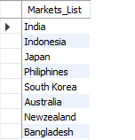
Result of Q1

Slide 4
Q2. What is the percentage of unique product increase in 2021 vs. 2020? The final output contains these fields, unique_products_2020, unique_products_2021, percentage_chg
Query
with cte1 as (select count(distinct p.product_code) as unique_product_count_2021 from dim_product p
join fact_sales_monthly f on p.product_code=f.product_code
where f.fiscal_year=2021),
cte2 as (select count(distinct p.product_code)
as unique_product_count_2020from dim_product p
join fact_sales_monthly f on p.product_code=f.product_code
where f.fiscal_year=2020)
select unique_product_count_2021,unique_product_count_2020,round(((unique_product_count_2021-unique_product_count_2020)/unique_product_count_2020)*100,2)
as percentage_chg from cte1,cte2;

Slide 5
Result of Q2

Slide 6
Q3. Provide a report with all the unique product counts for each segment and sort them in descending order of product counts. The final output contains 2 fields, segment product_count
Query
select p.segment, count(distinct p.product_code)
as product_count
from dim_product p
join fact_sales_monthly f
on p.product_code=f.product_code
group by p.segment
order by product_count desc;

Slide 7
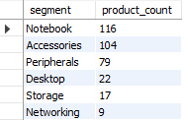
Result of Q3

Slide 8
Q4. Follow-up: Which segment had the most increase in unique products in 2021 vs 2020? The final output contains these fields, segment product_count_2020, product_count_2021, diff
Query
with cte2020 as
(select segment, count(distinct(p.product_code)) as unique_product_2020from dim_product p
join fact_sales_monthly f on f.product_code=p.product_code
where fiscal_year=2020
group by segment),
cte2021 as
(select segment, count(distinct(p.product_code)) as unique_product_2021from dim_product p
join fact_sales_monthly f on f.product_code=p.product_code
where fiscal_year=2021
group by segment)
select cte2020.segment, unique_product_2020, unique_product_2021,
(unique_product_2021-unique_product_2020) as Diff from cte2020
join cte2021 on cte2020.segment=cte2021.segment
order by diff desc;

Slide 9
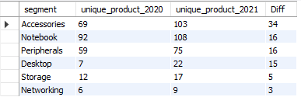
Result of Q4

Slide 10
Q5. Get the products that have the highest and lowest manufacturing costs. The final output should contain these fields, product_code, product, manufacturing_cost
Query
with cte1 as(
select m.product_code, p.product, m.manufacturing_cost,
rank() over(order by manufacturing_cost) as rnk from fact_manufacturing_cost m
join dim_product p
on m.product_code=p.product_code)
select product_code, product, manufacturing_cost from cte1
where rnk=1 or rnk=(select count(rnk) from cte1);

Slide 11
Result of Q5

Slide 12
Q6. Generate a report which contains the top 5 customers who received an average high pre_invoice_discount_pct for the fiscal year 2021 and in the Indian market. The final output contains these fields, customer_code, customer, average_discount_percentage
Query
select m.customer_code, d.customer,
round((avg(pre_invoice_discount_pct)*100))
as average_discount_percentage Output
from fact_pre_invoice_deductions m
join dim_customer d
on m.customer_code=d.customer_code
where m.fiscal_year=2021 and d.market='India'
group by m.customer_code,d.customer
order by average_discount_percentage desc
limit 5;

Slide 13
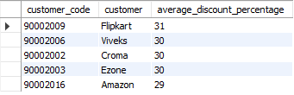
Result of Q6

Slide 14
Q7. Get the complete report of the Gross sales amount for the customer “Atliq Exclusive” for each month. This analysis helps to get an idea of low and high-performing months and take strategic decisions. The final report contains these columns: Month Year Gross sales Amount
Query
select extract(month from m.date) as Month, m.fiscal_year
as Year, round(sum(sold_quantity*gross_price),0)
as Gross_sales_Amount from dim_customer d
join fact_sales_monthly m
on d.customer_code=m.customer_code
join fact_gross_price g
on m.product_code=g.product_code
where d.customer='Atliq Exclusive'
group by Month, Year
order by Year, Month;

Slide 15
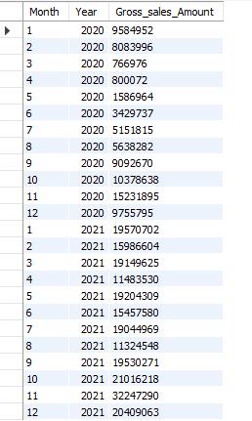
Result of Q7

Slide 16
Q8. In which quarter of 2020, got the maximum total_sold_quantity? The final output contains these fields sorted by the total_sold_quantity, Quarter total_sold_quantity
Query
select e.quarters, sum(e.sold_quantity)
as total_sold_quantity from Output
(select *,
case when month(date) in ( 09,10,11) then 'Q1'
when month(date) in (12,1,2) then 'Q2'
when month(date) in (3,4,5) then 'Q3'
else 'Q4'
end as quarters
from fact_sales_monthly) as e
where fiscal_year=2020
group by e.quarters
order by total_sold_quantity desc;

Slide 17

Result of Q8

Slide 18
Q9. Which channel helped to bring more gross sales in the fiscal year 2021 and the percentage of contribution? The final output contains these fields, channel, gross_sales_mln, percentage
Query
with cte as (
select channel,(sum(sold_quantity*gross_price))/1000000 as gross_sales_mln from fact_gross_price f
join fact_sales_monthly d
on f.product_code=d.product_code
join dim_customer c on d.customer_code=c.customer_code
where f.fiscal_year=2021
group by channel
order by gross_sales_mln desc)
select *, round(100.0*gross_sales_mln/ (select sum(gross_sales_mln) from cte),2) as percentage from cte
group by 1, 2, 3;

Slide 19

Result of Q9

Slide 20
Q10. Get the Top 3 products in each division that have a high total_sold_quantity in the fiscal_year 2021? The final output contains these fields, division, product_code, product total_sold_quantity, rank_order
Query
select * from
(select p.division, s.product_code, p.product, sum(s.sold_quantity) as total_sold_quantity,
rank() over(partition by p.division
order by sum(s.sold_quantity) desc) as rank_order from fact_sales_monthly s
join dim_product p on s.product_code=p.product_code
where s.fiscal_year=2021
group by p.division, s.product_code, p.product)e
where rank_order<=3;

Slide 21
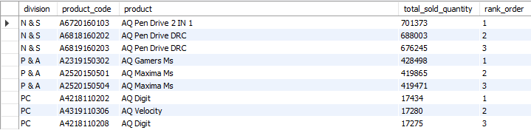
Result of Q10

Slide 22
Thank You..!

